Slide 1
Netflix DS BootCamp
Group 3’s Final Project:
Analysis of Key
Heart Disease Indicators
By:
Elliott Einstein
Frank King
Jorge Angon
Saad Iqbal

Slide 2
Table of Contents
01
02
03
04
Dataset &
Cleanup
Research Questions/Hypotheses & Findings
Machine Learning Model
Problems & Future Considerations

Slide 3
01
Dataset & Cleanup

Slide 4
Dataset
2020 annual CDC survey data (BMI, smoking, alcohol drinking, mental health) of 400k adults related to their health status (N = 319,795)
According to the CDC, heart disease is one of the leading causes of death for people of most races in the US
About half of all Americans (47%) have at least 1 of 3 key risk factors for heart disease: high blood pressure, high cholesterol, and smoking
Notes:
Why this dataset? - 2nd and 3rd bullet points

Slide 5
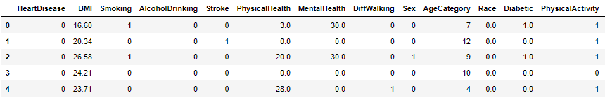
Clean-up Process
Changed all binary text responses (“Yes”/”No”) to binary number (“1”/”0”)
Split up Race variable
For MLM, removed all null values

Slide 6
02
Research Questions/Hypotheses & Findings

Slide 7
Question 1:
Hypothesis 1:
Does biological sex and BMI influence if someone develops a heart disease or not?
Biological sex and BMI will have a significant influence on the development of heart disease.

Slide 8
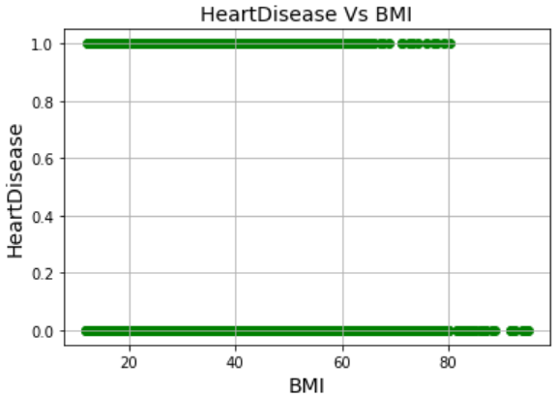
Question 1 - Analysis
Variable | P - Value | Adj. R²
BMI | < 0.01 | 0.007
Sex | < 0.01

Slide 9
Question 2:
Hypothesis 2:
Does the amount of sleep a person gets influence if they will develop a heart disease?
Less sleep time is correlated to the development of a heart disease.

Slide 10
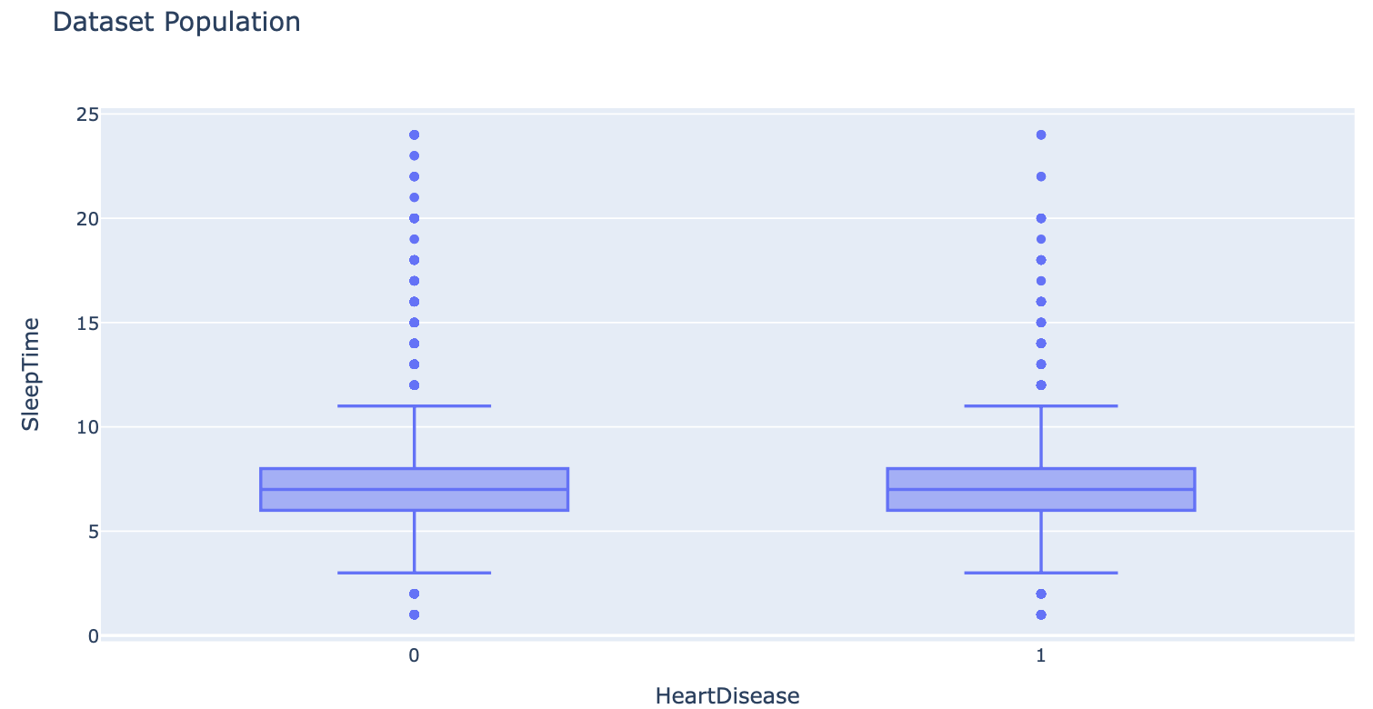
Question 2 - Analysis
Sample | Median Sleep Time (hours)
0 - Reported no heart disease | 7
1 - Reported heart disease | 7

Slide 11
Dataset Population 2 Sample T-Test
Sample | P- Value
Sleep time (h) of people that reported heart disease | 2.492 e-06
Sleep time (h) of people that didn’t report heart disease
Sample | Mean Sleep Time (hours)
0 - Reported no heart disease | 7.093
1 - Reported heart disease | 7.136

Slide 12
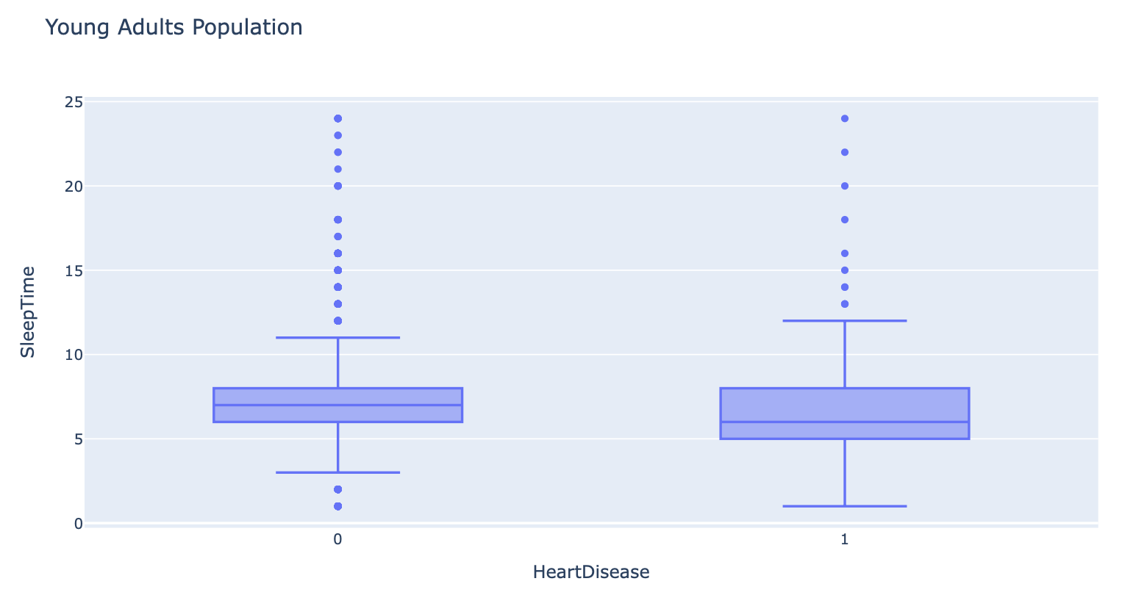
Young Adults Population (18-44)
Young Adults Sample | Median Sleep Time (hours)
0 - Reported no heart disease | 7
1 - Reported heart disease | 6

Slide 13
Young Adults Population 2 Sample T-Test
Sample | P- Value
Sleep time (h) of young adults that reported heart disease | 3.0132 e-32
Sleep time (h) of young adults that didn’t report heart disease
Sample | Mean Sleep Time (hours)
0 - Reported no heart disease | 6.963
1 - Reported heart disease | 6.504

Slide 14
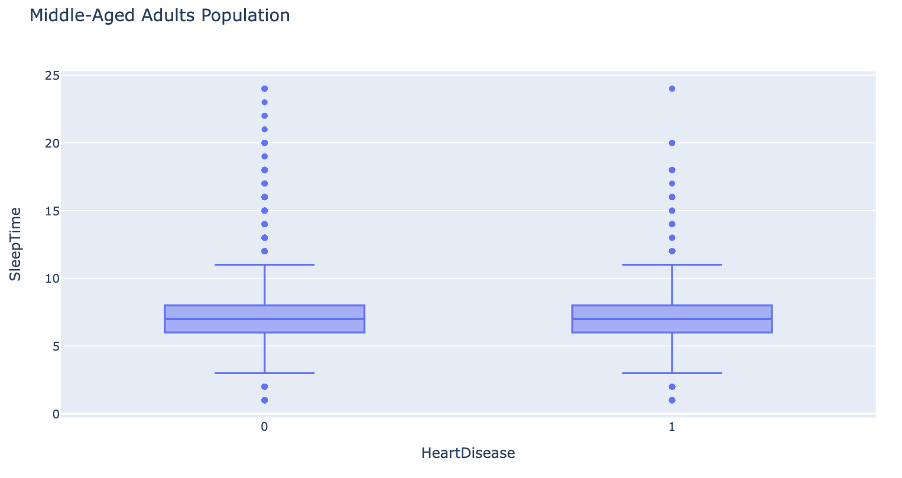
Middle-Aged Adults Population (45-64)
Middle-Aged Adults Sample | Median Sleep Time (hours)
0 - Reported no heart disease | 7
1 - Reported heart disease | 7

Slide 15
Middle-Aged Adults Population 2 Sample T-Test
Sample | P- Value
Sleep time (h) of middle-aged adults that reported heart disease | 1.824 e-32
Sleep time (h) of middle-aged adults that didn’t report heart disease
Middle- Aged Adults Sample | Mean Sleep Time (hours)
0 - Reported no heart disease | 6.986
1 - Reported heart disease | 6.786

Slide 16
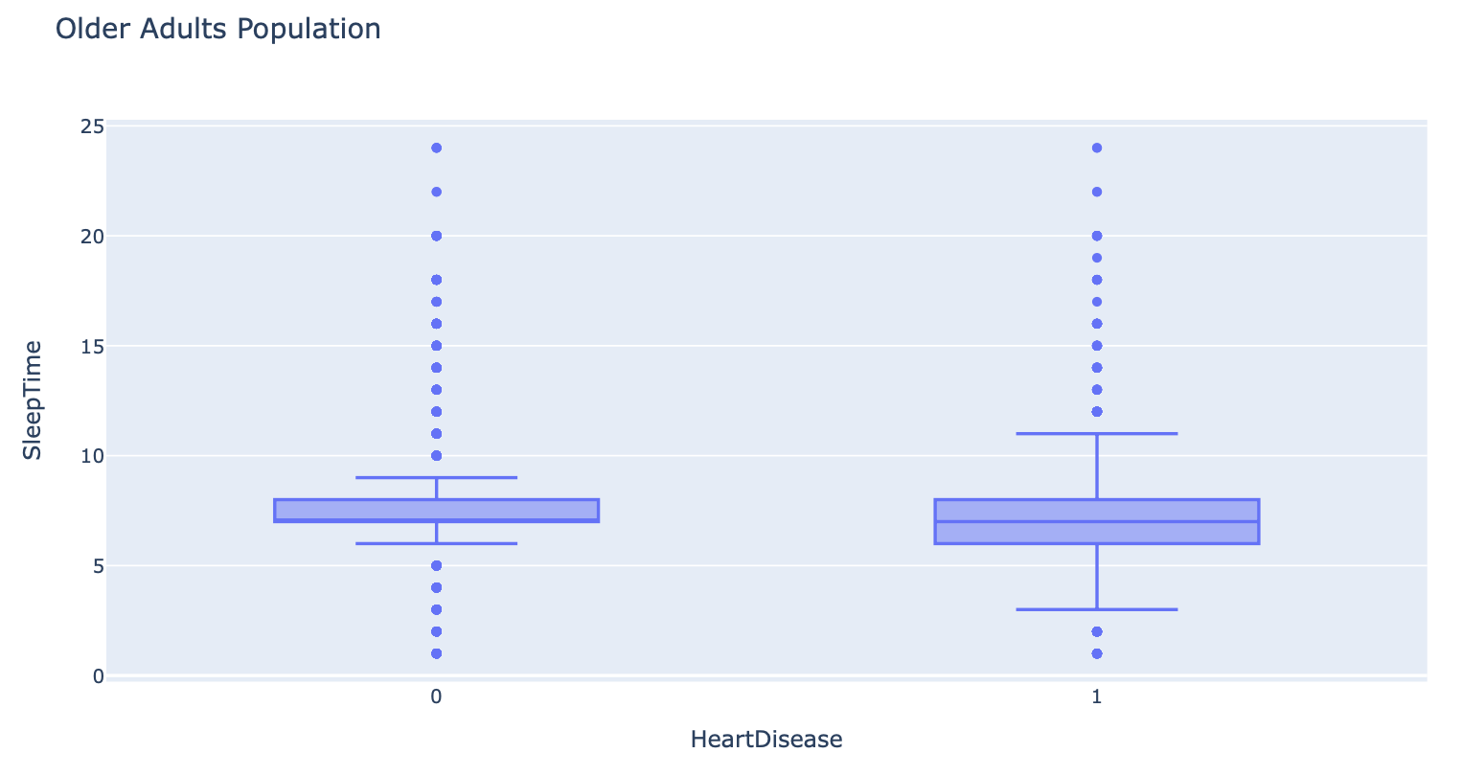
Older Adults Population (65+)
Older Adults Sample | Median Sleep Time (hours)
0 - Reported no heart disease | 7
1 - Reported heart disease | 7

Slide 17
Older Adults Population 2 Sample T-Test
Sample | P- Value
Sleep time (h) of older adults that reported heart disease | 0.0347
Sleep time (h) of older adults that didn’t report heart disease
Older Adults Sample | Mean Sleep Time (hours)
0 - Reported no heart disease | 7.350
1 - Reported heart disease | 7.325

Slide 18
Reported No Heart Disease - ANOVA Analysis
Sample | Mean Sleep Time (hours) | P - Value
Sleep time of young adults that didn’t report heart disease | 6.963 | < 0.01
Sleep time of middle-aged adults that didn’t report heart disease | 6.986
Sleep time of older adults that didn’t report heart disease | 7.350

Slide 19
Reported Heart Disease - ANOVA Analysis
Sample | Mean Sleep Time (hours) | P-Value
Sleep time of young adults that reported heart disease | 6.504 | 7.229 e-147
Sleep time of middle-aged adults that reported heart disease | 6.786
Sleep time of older adults that reported heart disease | 7.325

Slide 20
Question 3:
Hypothesis 3:
Is there a relationship between age, stroke and heart disease?
There will be a strong, positive relationship between age and stroke/heart disease.

Slide 21
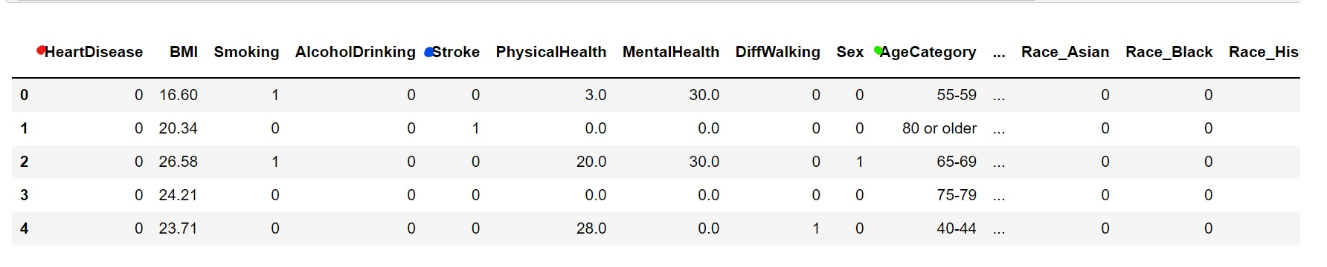
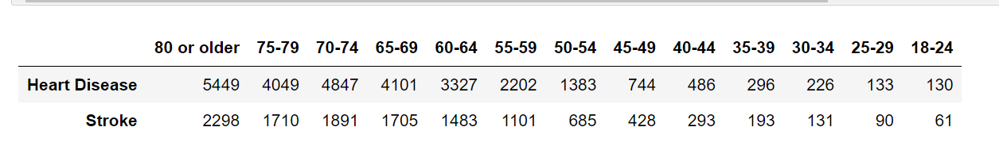
Question 3 -Analysis
Qualitative Data
Numerical Data

Slide 22
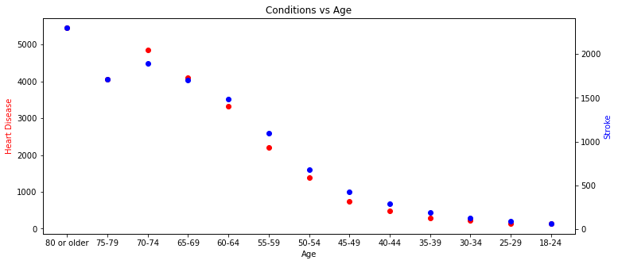
Question 3- Analysis
The data is random

Slide 23
Question 3- Analysis
Due to my variables of interest being categorical, I used the Chi-squared Test to understand if there is significant relationship amongst heart disease, stroke and age.
The Chi-squared Test differs from the Anova, the variations of the T-Test (in class) because these test are more associated with significance between the means and the data is usually continuous.
Notes:
The Chi-squared Test is a test used to determine whether the association between categorical variables are statistically significant.

Slide 24
Question 3- Analysis
scipy.stats.chi2_contigency()

Slide 25
Question 3- Analysis
Test Results
Statistical Value | 119.823
P-value | 6.704e-20
Degrees of Freedom | 12
This means that we reject the null hypothesis and there is a significant association between the categories.

Slide 26
03
Machine Learning Model

Slide 27
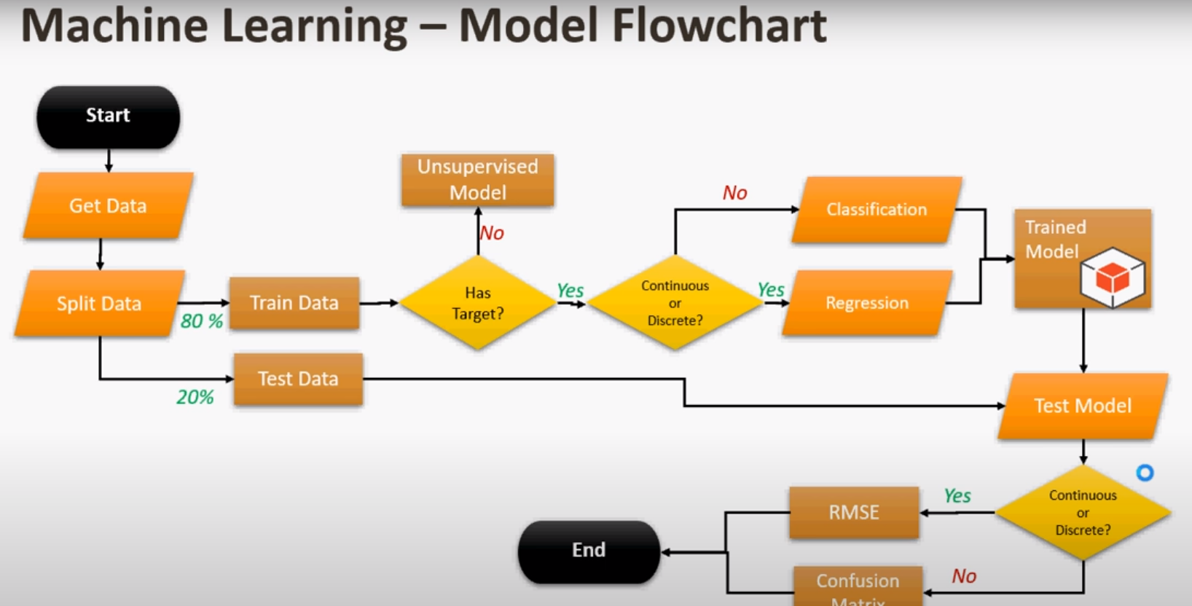
Machine Learning Classifiers
RandomForestClassifier
01
Mars
Despite being red, Mars is actually a cold place
ExtraTreesClassifier
02
AdaBoostClassifier
03

Slide 28
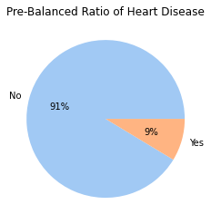
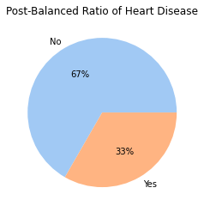
Data Pre-Processing
Negative Heart Disease Count: (276603)
Positive Heart Disease Count: (26220)
Negative Heart Disease Count: (52440)
Positive Heart Disease Count: (26220)
Random Under-Sampling

Slide 29
Confusion Matrix
Classification Report
A Confusion Matrix compares the predicted values from a model against the actual values.
Accuracy = TP + TN / (TP + TN + FP + FN)
Is the percentage of correct predictions.
Precision = TP / (TP + FP)
Is the percentage of positive predictions that are correct.
Recall/Sensitivity
Recall = TP / (TP + FN)
Is the percentage of actual positive results that are predicted correctly. Sometimes it is called
the True Positive Rate
F1 Score
Harmonic mean, balances Precision and Sensitivity.
F1 = 2(Precision * Sensitivity) / (Precision + Sensitivity)
Notes:
A Confusion Matrix compares the predicted values from a model against the actual values.

Slide 30
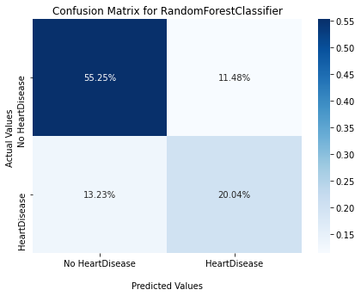

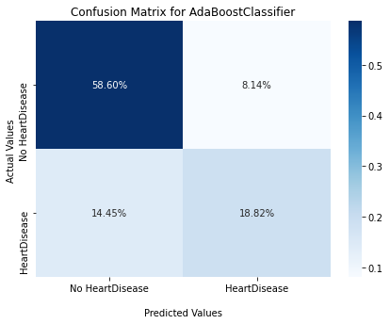
Machine Learning Models Confusion Matrices

Slide 31
Model Comparisons
Winner
RandomForestClassifier classification report
ExtraTreesclassifier classification report
precision recall f1-score support
Negative 0.81 0.83 0.82 13123
Positive 0.64 0.60 0.62 6542
accuracy 0.75 19665
macro avg 0.72 0.72 0.72 19665
weighted avg 0.75 0.75 0.75 19665
precision recall f1-score support
Negative 0.80 0.81 0.81 13123
Positive 0.61 0.59 0.60 6542
accuracy 0.74 19665
macro avg 0.71 0.70 0.70 19665
weighted avg 0.74 0.74 0.74 1966
AdaBoostClassifier classification report
precision recall f1-score support
Negative 0.80 0.88 0.84 13123
Positive 0.70 0.57 0.62 6542
accuracy 0.77 19665
macro avg 0.75 0.72 0.73 19665
weighted avg 0.77 0.77 0.77 19665
0.77

Slide 32
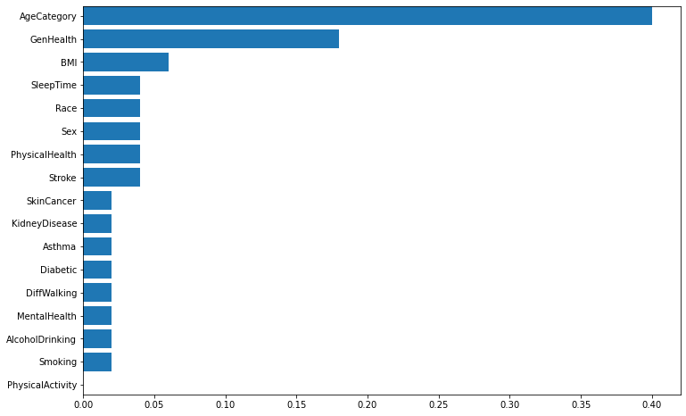
Can we identify which variables has the most influence on the development of heart disease?

Slide 33
04
Problems & Future Considerations

Slide 34
Problems and Future Considerations
Huge dataset so analysis would take a long time to load
Limitation: disparity between those who have heart disease and those who do not
NIH should focus on funding sleep, strokes, weight, and substance use, racial disparities, and mental health research
NIH should also hold webinars and conferences to have open discussions on how to implement lifestyle changes

Slide 35

THANK YOU FOR LISTENING!

